Slide 1
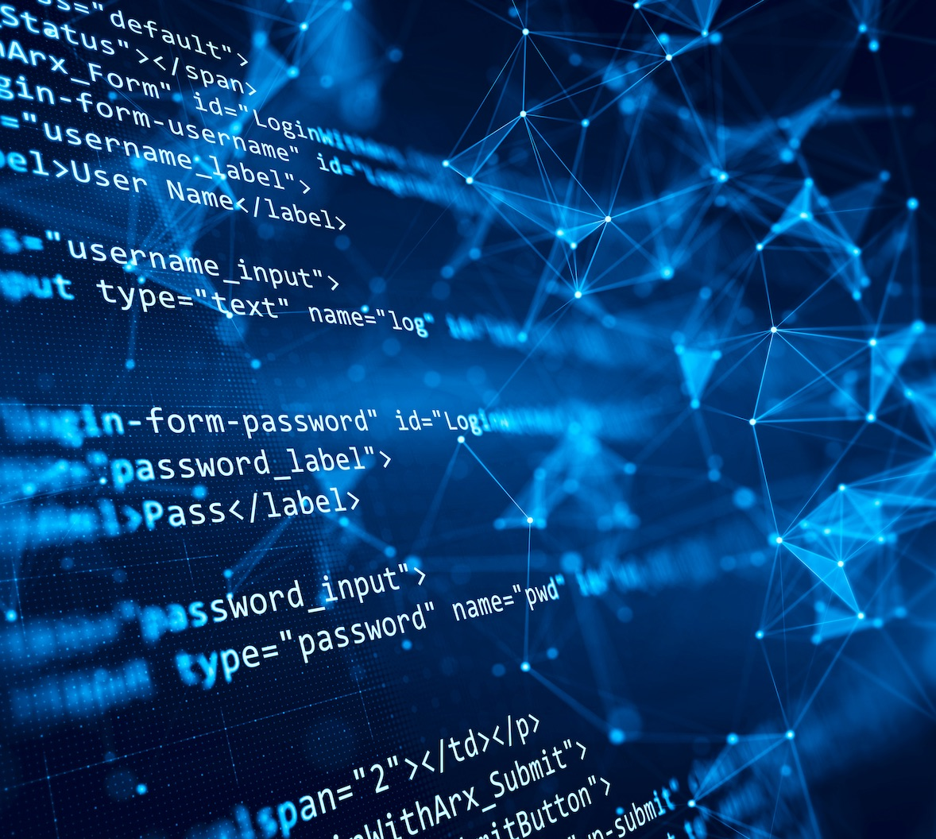

Team 55: Research Lab
Inventory Tracker
Bi-Weekly Update 5 Lizzett Tapia
Sumedha Bhattacharyaa
Jonathan Moore
Evan Ross TA: Niloofar Borzooei
Notes:
Michelle

Slide 2
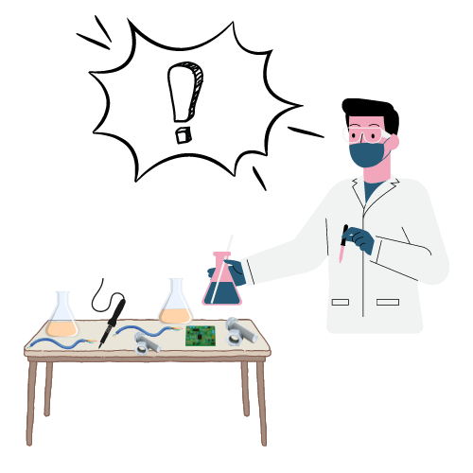
Problem Statement
“The current lab inventory tracking systems at Texas A&M are inefficient, and it is necessary to create new, organized software to increase the overall performance and efficiency of the Lab.”

Slide 3
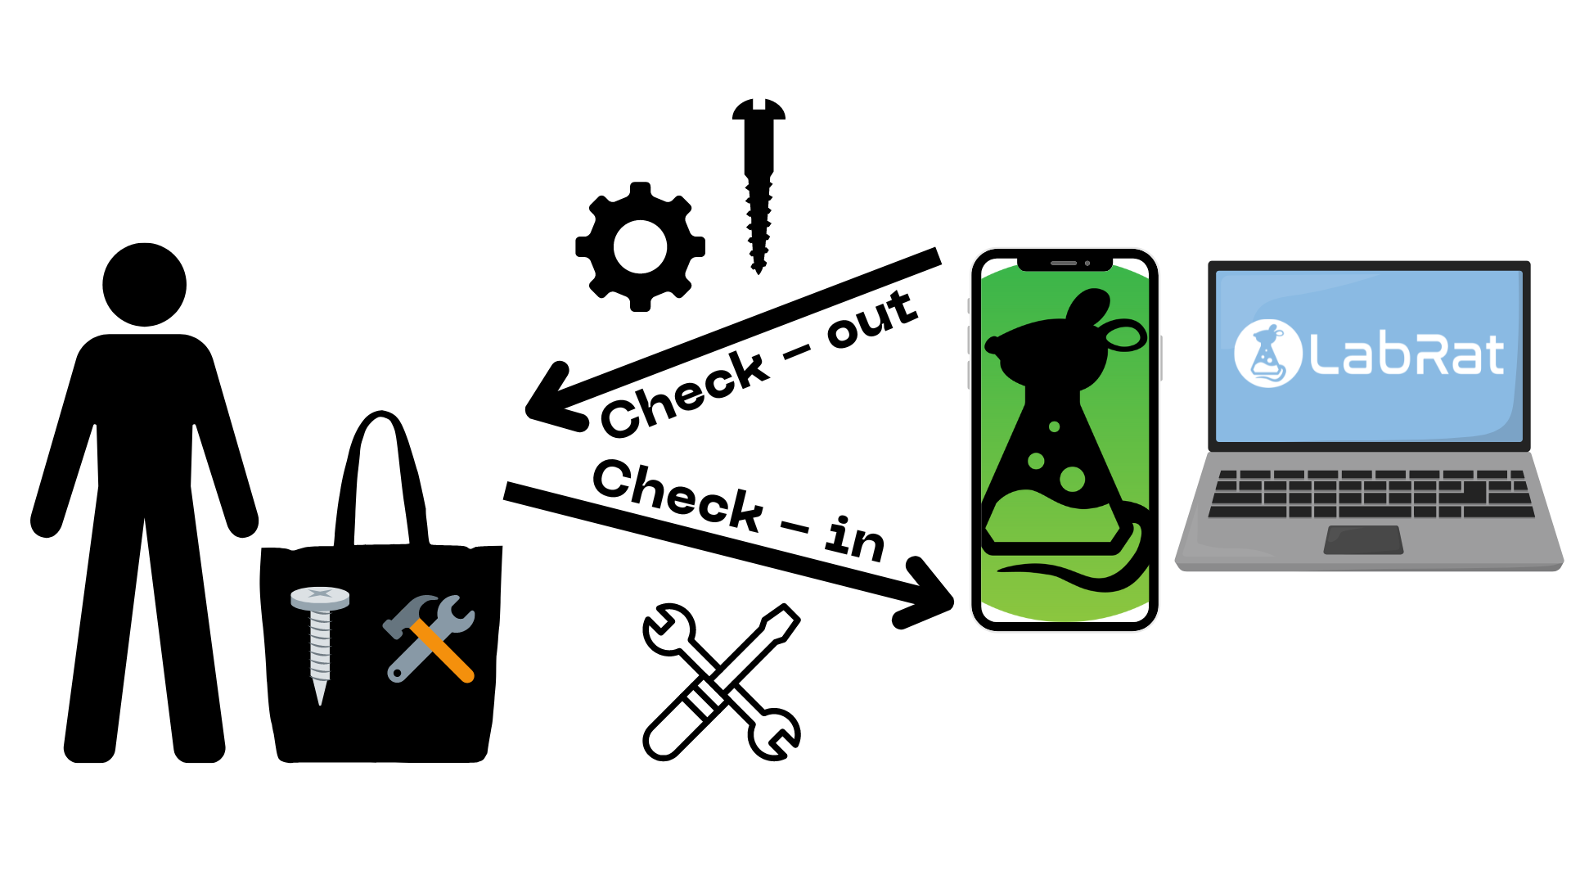
Solution Proposal
“Develop a web and mobile application integrated with a database to streamline inventory management in TAMU labs. The mobile app uses a machine learning-based image classification system to allow users to easily check items in and out by scanning them.”

Slide 4
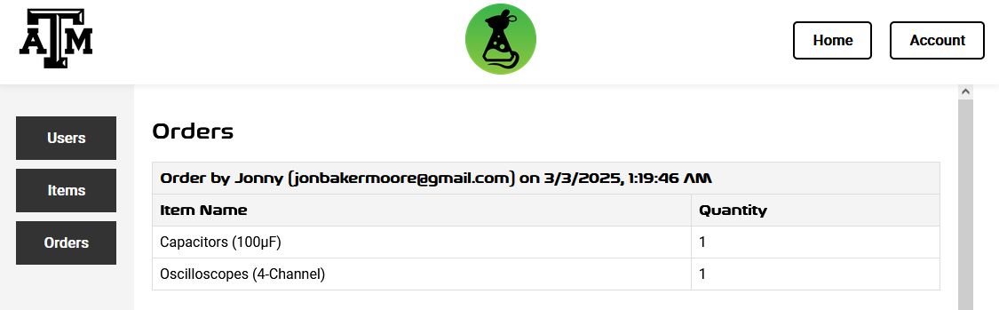
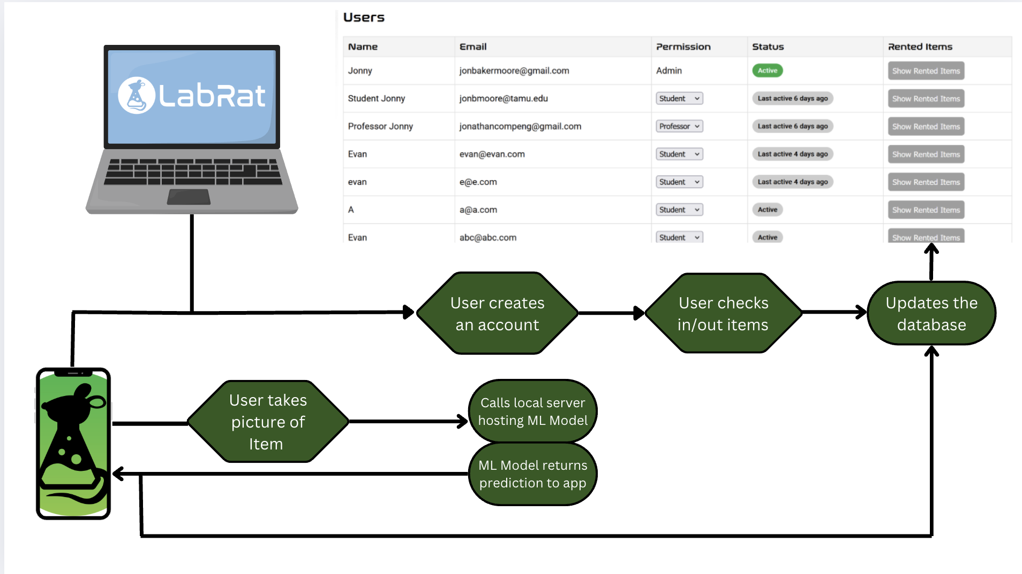
Integrated System Diagram
Notes:
Eric

Slide 5
Project Timeline
Subsystem Designs and Testing (completed 1/27) | Integration preparation of server with website and mobile app (completed 2/3) | Integration of ML model with mobile application (to complete by 2/27) | Final Integration (to complete by 3/3) | System Tests (to complete by 3/24) | Validation (to complete by 4/14) | Demo and Report (to complete by 4/21 and 4/28 respectively)

Slide 6
Android App
Accomplishments since last update 10 hrs of effort | Ongoing progress/problems and plans until the next presentation
Fully integrated with machine learning and validating to ensure functionality Validating Database functionality Ensure functionality on physical Phone | Validate machine learning and Database integration Small UI tweaks

Slide 7
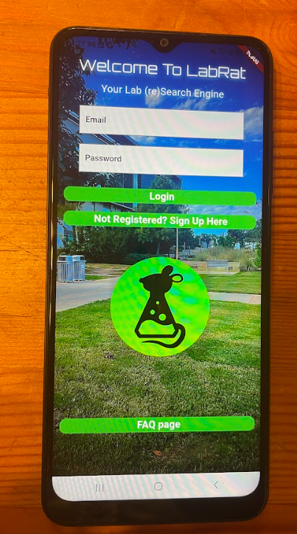
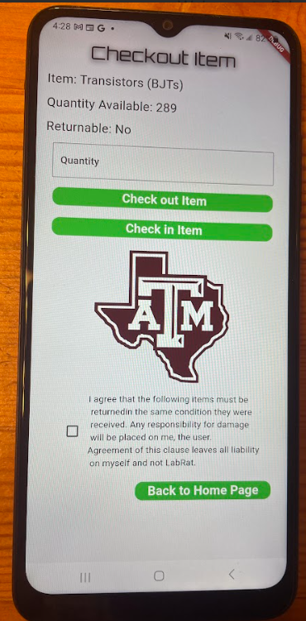
Android App

Slide 8
Database Server
Accomplishments since last update 9 hrs of effort | Ongoing progress/problems and plans until the next presentation
Tested data insertion & retrieval Validated data handling & data integrity Completed validation for security and backup | Finish up the rest of the validation tests found in our validation plan

Slide 9
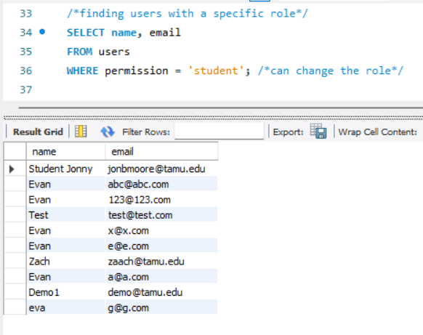
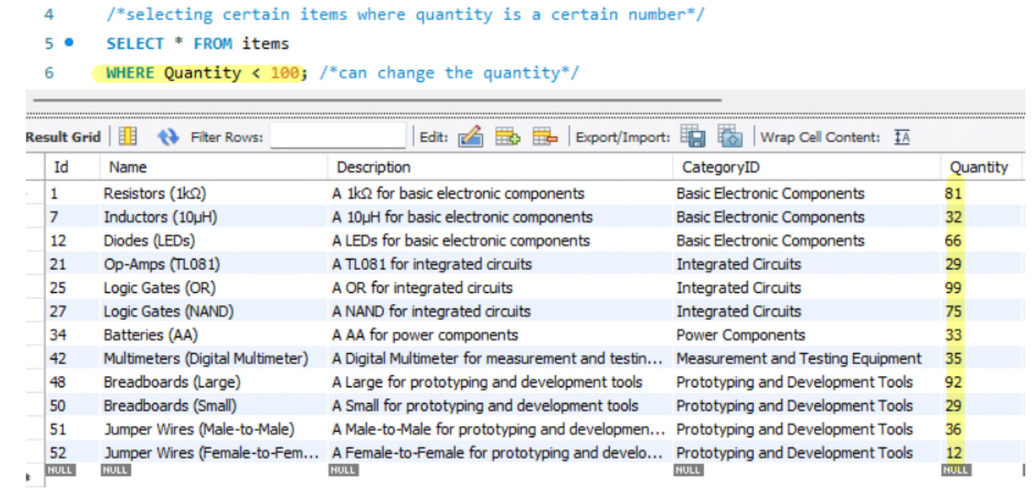
Database Server
Notes:
top two pics are completed SQL queries: making sure data retrieval is functioning correctly
bottom pic shows that the Automated Backups feature is enabled, by showing the earliest and latest restorable time

Slide 10
Machine Learning Model
Accomplishments since last update 9 hrs of effort | Ongoing progress/problems and plans until the next presentation
Validated that entire system allows model retraining Validated correct identification of all items using the ML Model on the Mobile App Validated images get saved for troubleshooting purposes | Ongoing dataset modification to increase accuracy for capacitors (from 80% to 90%) Ongoing validation to monitor proper function

Slide 11
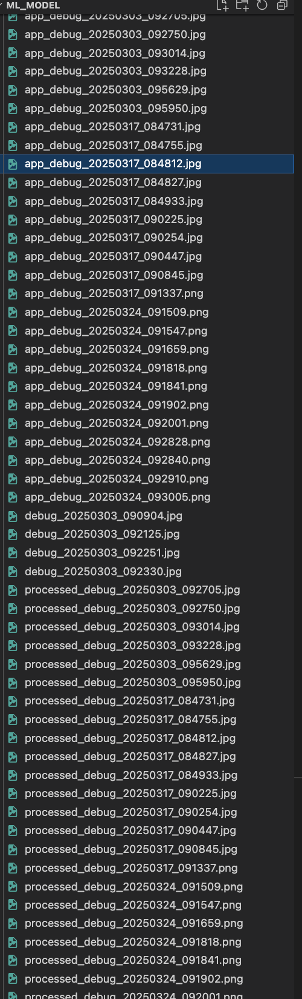
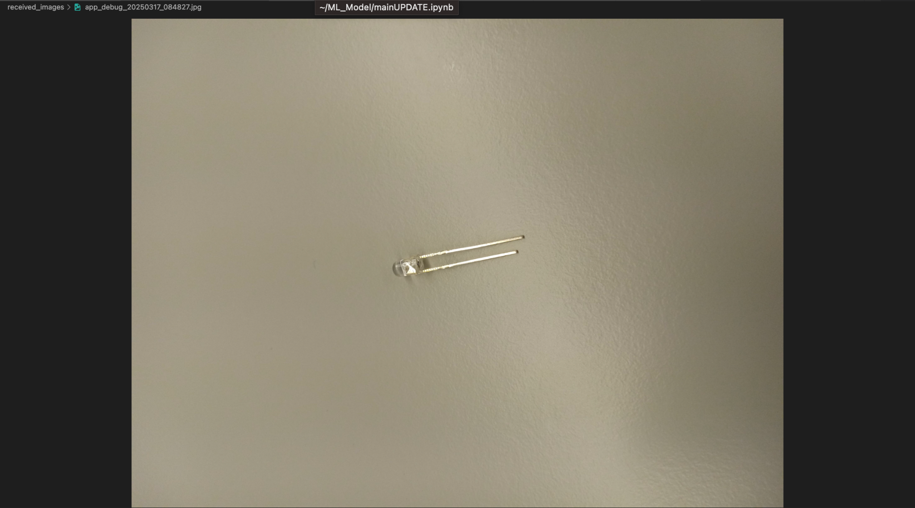
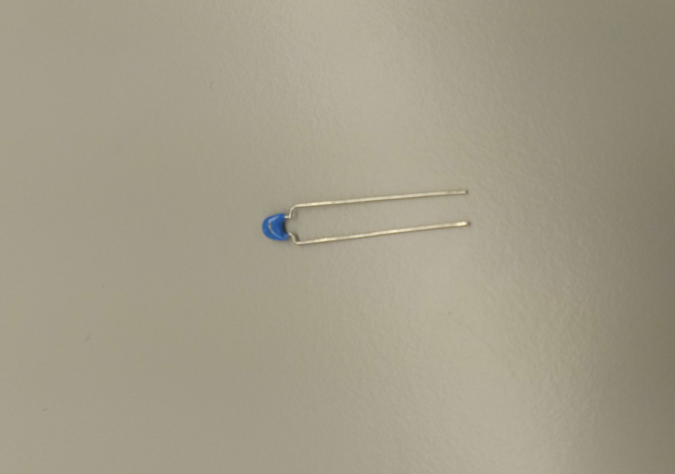
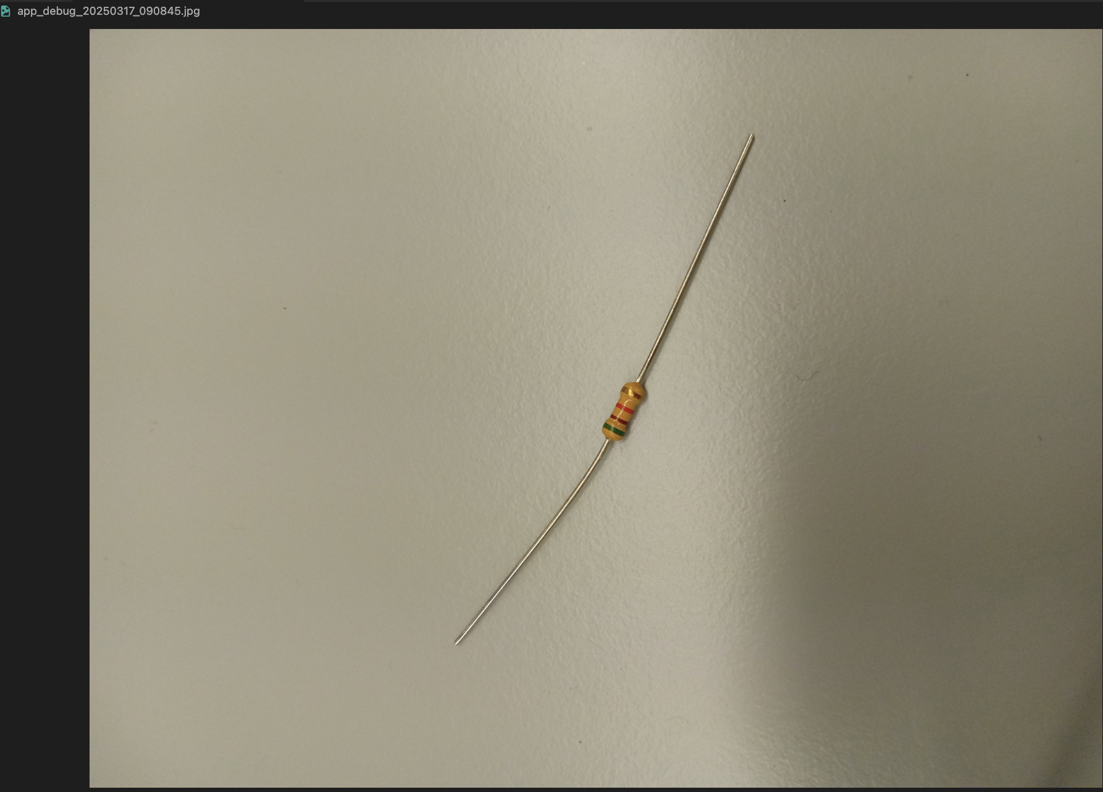
Machine Learning Model

Slide 12
Website
Accomplishments since last update 8 hrs of effort | Ongoing progress/problems and plans until the next presentation
Validated more requirements (certificate authentication, data integrity) Bug squashing | Continuing validation before final presentation.

Slide 13
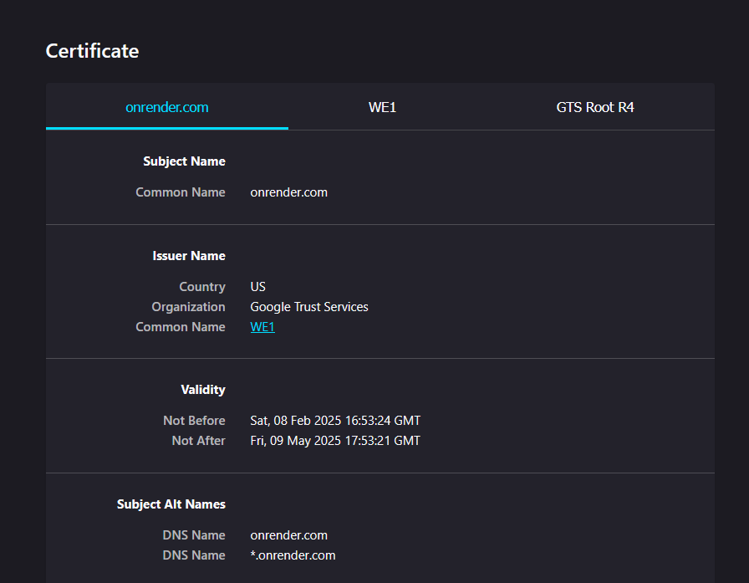
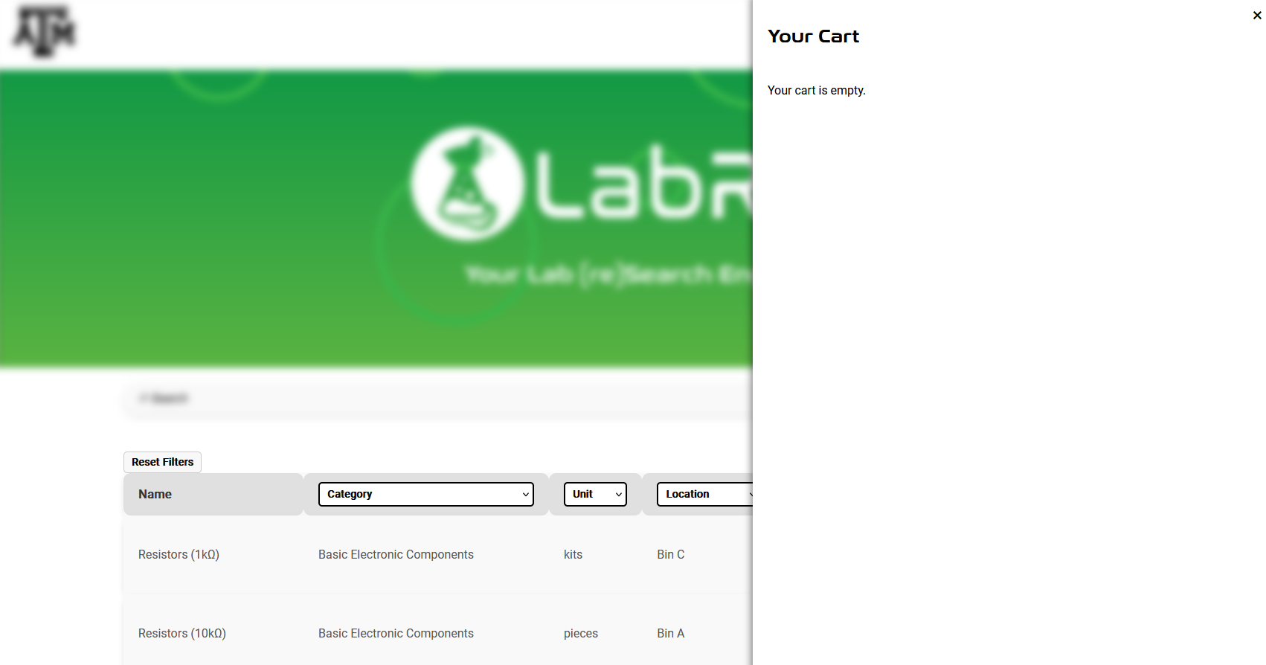
Website

Slide 14
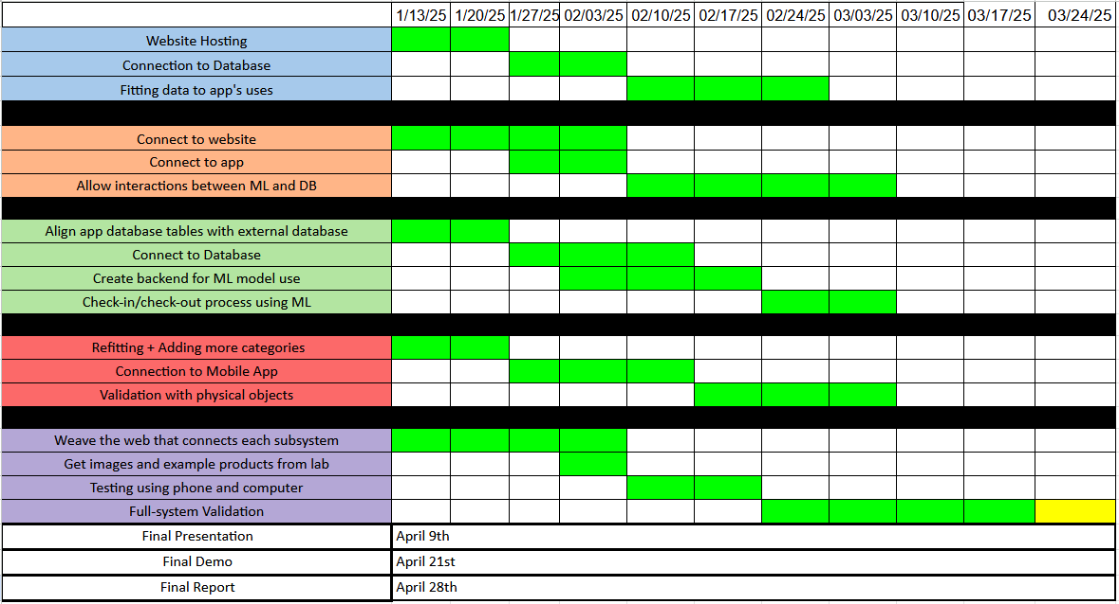
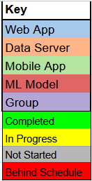
Execution Plan
Notes:
Michelle

Slide 15
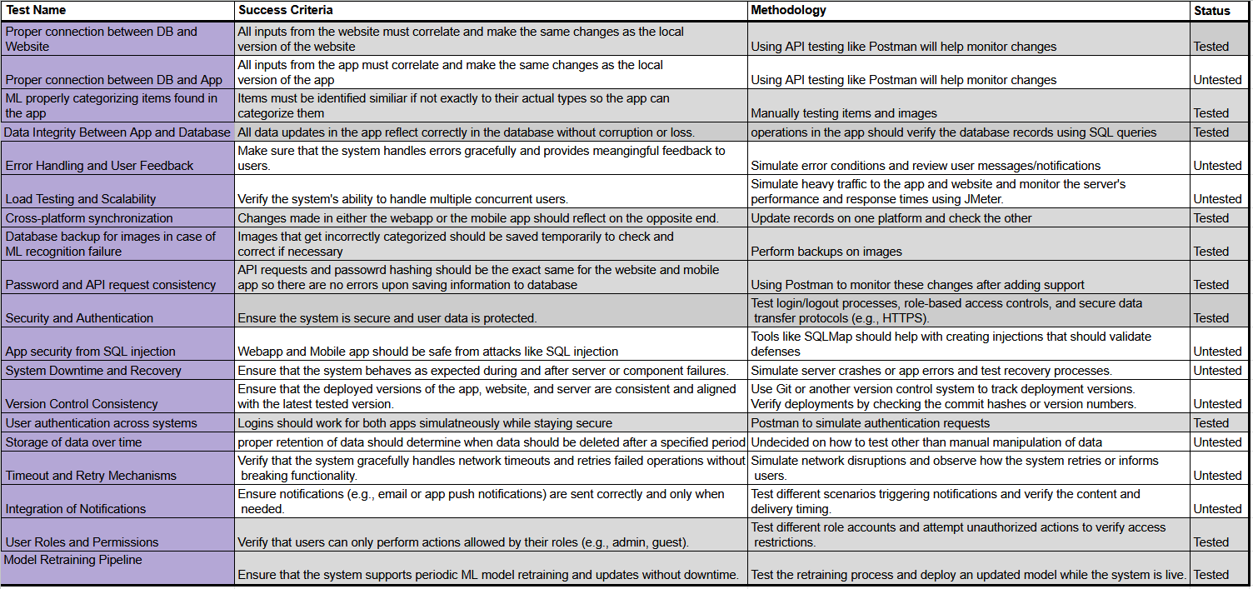
Validation Plan
Notes:
Michelle

Slide 16
Thank You For Listening!

